Slide 1
자료구조 프로젝트 은행 시스템
2011104048 정윤아

Slide 2
1. architecture
ClientList
ClientData
Client1
Account
account1
Application
Doubly
▶ Application has Doubly<ClientData> ClientList
▶ ClientList has Doubly<account> Account
▶ Used lab sorce of data structure class

Slide 3
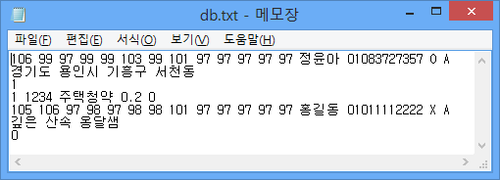
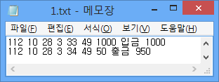
2. My Functions
File Input / Output
▶ Get Client List Data from file when start program
▶ Record breakdown

Slide 4
2. My Functions
Encryption Social security number
▶ You can’t figure out what those numbers mean

Slide 5
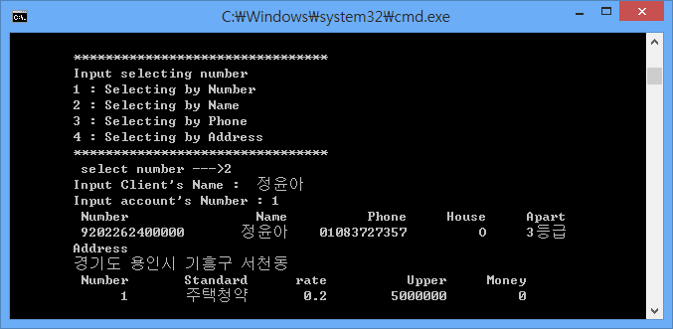
2. My Functions
Apartment Subscription
▶ Give ranking by several standards

Slide 6
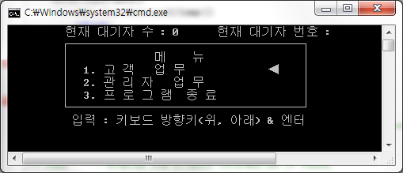
2. My functions
Easy interface
▶ You can select menu with arrow button

Slide 7
Run application

Slide 8
Thanks, q n a

